Slide 1
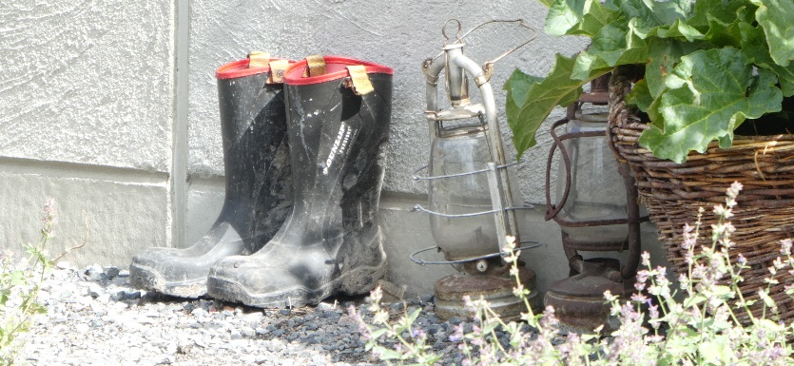
A divided village: a narrative study using a theoretical lens of speculative ontology
Professor Maggie Bartlett
University of Dundee School of Medicine

Slide 2
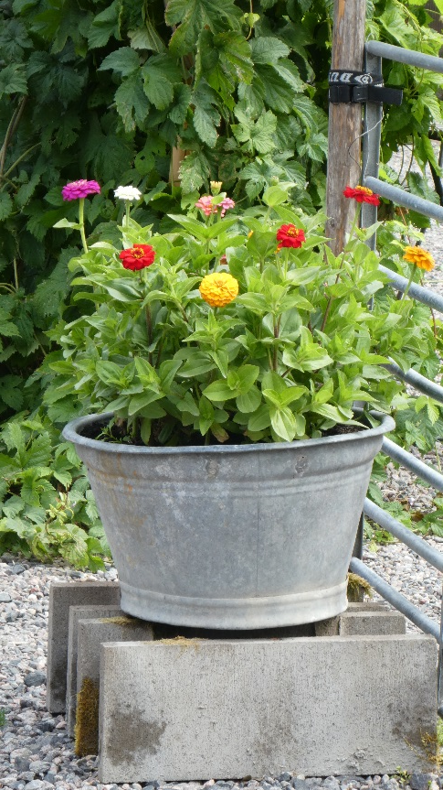
Introduction
Population of Ambridge | ̴̴700*
Number of named and voiced characters | ̴̴70**
Number of named but unvoiced characters | ̴̴10**
Number of unvoiced and un-named characters | ̴̴ 620
*Stepney R. A series of unfortunate events? Morbidity and mortality in a Borsetshire village. 2011. British Medical Journal. Doi:10.1136/bmj.d7518 (accessed 22.8.19)
**https://www.bbc.co.uk/programmes/profiles/3VLG6MxxfQpKXF2Chky4Fmh/characters

Slide 3
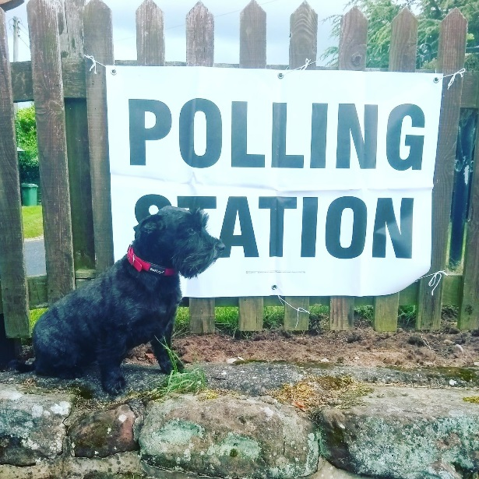
Aim
To explore the ontological position of this un-named and unvoiced group

Slide 4
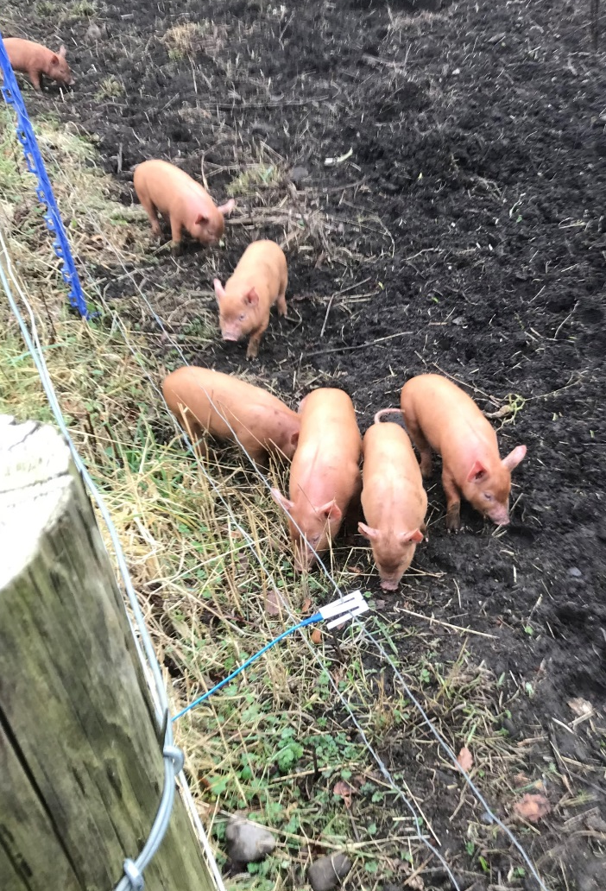
Method
Purposive sampling (16 people > 16 years old)
Focus groups (two x 1h - 8 people)
Phenomenological approach
Interpretive paradigm
Speculative Ontology
Themes identified from the data
Ethics

Slide 5
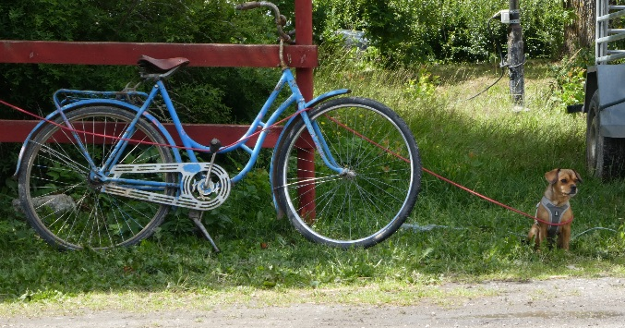
Results - demographics
ID/gender | Occupation | Age
PO/f | Granny providing child care | 75
RD/f | Midwife | 55
AW/f | Bus driver | 50
DP/f | Refuse collection operative | 38
GY/f | Self –employed spinner/dyer | 35
TR/f | Airline Pilot on maternity leave | 34
AM/f | Junior hospital doctor | 25
QZ/f | Apprentice narrow boat builder | 17
ID/gender | Occupation | Age
GH/m | Retired jelly baby maker | 80
LY/m | Primary school teacher | 55
TS/m | Electrical Engineer | 48
NV/m | Llama farmer | 41
GA/m | Synchronised swimmer | 35
IM/m | District Nurse | 29
UL/m | Artificial inseminator | 25
XZ/m | Giblet processor (chicken factory) | 18

Slide 6
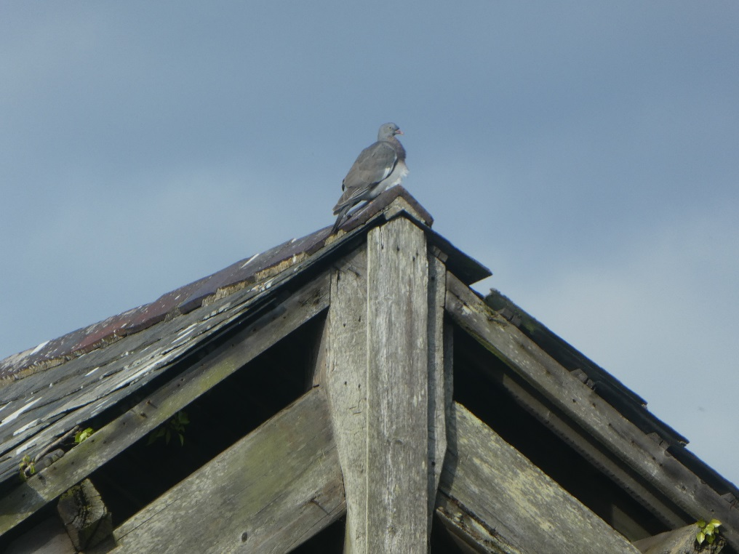
Results – three main themes

Slide 7
Theme 1- an existential co-dependence
“ …they need us – how could there be a shop with no customers..?” GH/m
“…and we need them – would we be here without them? I’m not sure we would- but it’s not like it’s the Truman Show – is it ?” UL/m
“more like the chicken and the egg really…”NV/m
“ Bridge Farm – they need us – think of all the things that wouldn’t have happened if there wasn't the tea room- and a tea room needs customers too- bit pricey in the farm shop though…” PO/f
“ both too pricey for me - I go to Aldi on the bypass- means I miss out on a lot, but at least I don’t get caught in the cross fire…” GY/f

Slide 8
Theme 2- resentment and aspiration to have a voice but fear of having one
“… when anything happens to one of them, there’s a big hoo-ha, lots of sympathy and casserole - when my Pearl died it would have been nice to have had a mention -she was a friend of Jill Archer - and there was nothing- she could’ve brought me a casserole- and I could’ve said how hard it was- just one little sentence… ” GH/m
“…yeah, but if you did, nothing would be simple then. You’d have had to be depressed, or your Jerry would’ve gone off the rails, or you’d be burgled during the funeral – or fall in love with someone really awful.” TR/f
“probably not worth it, really, the risk, just for a moment of being. I like a quiet life, safely off their radar…I’m happy just to roar in the Bull once in a while” TS/m

Slide 9
Theme 2- resentment and aspiration to have a voice but fear of having one
“when good things happen, they don’t come up in the gossip…when our Lyra won that medal…they could’ve talked about that - things to be proud of in the village, and just a mention wouldn’t do any harm…” RD/f
“…it would be nice, just now and then, to be a little bit known. Not enough for bad things to happen- them not knowing anything about you when they know so much about the others - and it’s hard having to wait so long to get served in the shop or the Bull cos that Jim Lloyd’s having a rant or Kenton and Jolene are having some kind of drama, when all you want is a quick loaf or a G&T – I feel like a second class citizen, no actually a third class citizen, sometimes” AW/f

Slide 10
Theme 3- empathy for the named and unvoiced
“The thing is- the minute they know who you are, you’re in for something – that’s the price you pay…” UL/m
“yes, or you get taken the mickey of…” GY/f
“yeah, like poor old Mr Pullen…” LY/m
“yeah, or that woman Alistair Lloyd slept with a while back…” GY/f
“ and you don’t get to say anything about it at all…” GA/m
“ what about the Button girls – they’re at risk, I’d say.” LY/m
“ do you think their parents know?” GY/f
“should we make sure they do? We should do something.” QZ/f
“no, no, no – we can’t do that – that’s not right at all.” DP/f

Slide 11
Conclusions
The un-named, unvoiced population of Ambridge exist in a state of ontological tension arising from their
perceived existential co-dependence with the other two groups
uncertainty about the nature of their existence
wish to be known to exist and to be heard
awareness that this would result in a greater likelihood of adverse life events
This long term stress is likely to impact on their wellbeing*
This study raises a question about the creator’s moral responsibility for this group.
*McEwan BS. Neurobiological and Systemic Effects of Chronic Stress. Chronic Stress. (Thousand Oaks). 2017.
Jan-Dec;1. Doi:10.1177/2470547017692328. Epub 2017 Apr 10.

Slide 12
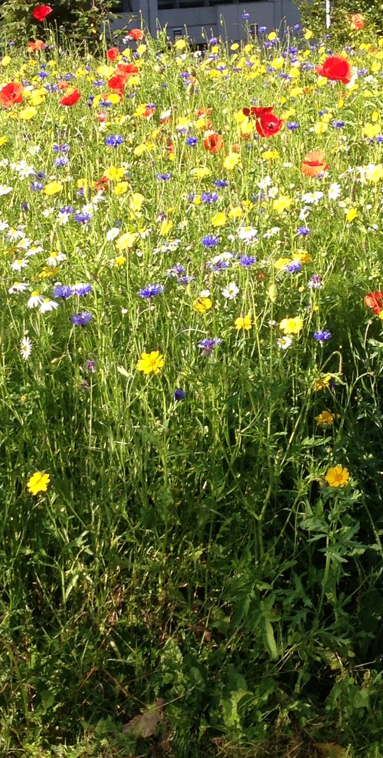
Questions, comments…?

